Slide 1
2018 - 2020
«The European cultural framework promotes social inclusion increasing the skills of our disadvantaged students»
My County – My town

Slide 2
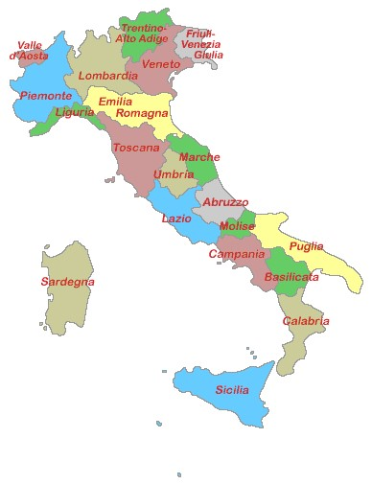
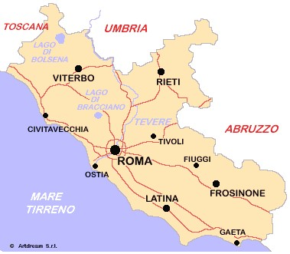
Sermoneta is a small city 80 Km south east of the capital city Rome in the Lazio County.
It is located 15 Km far from the chief town Latina.
It has around 10.000 Inhabitants.
My County
SERMONETA

Slide 3
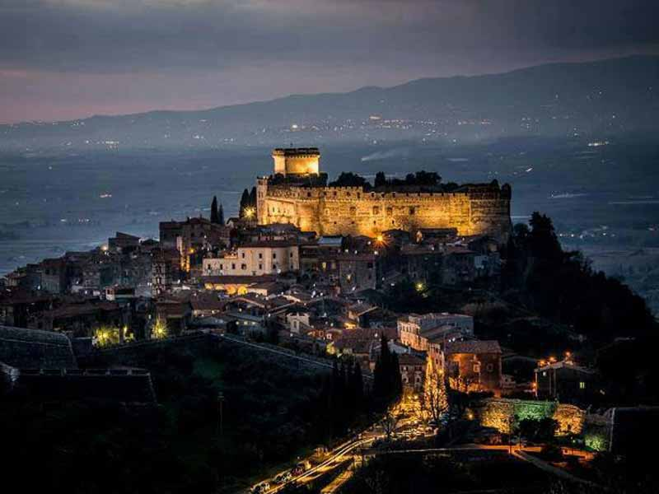
Sermoneta (IT)
My town
Sermoneta stands majestically on top of a hill, at 257 metres above sea level, dominating the Pontine plains below.

Slide 4
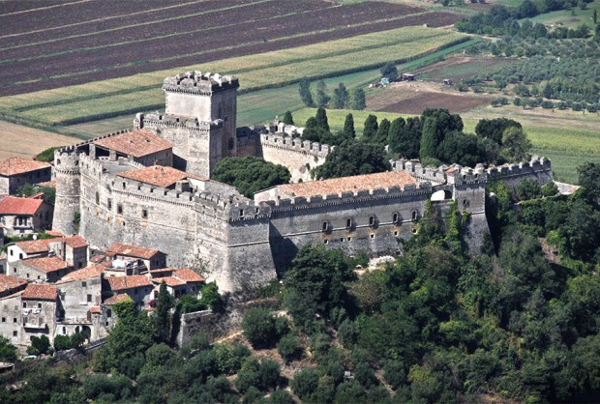
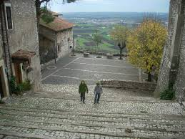
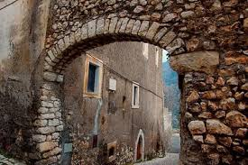
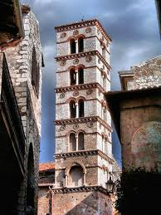
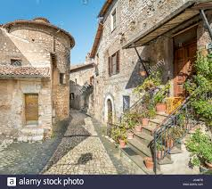
Castello Caetani is undoubtedly the symbol of Sermoneta and its main tourist attraction

Slide 5
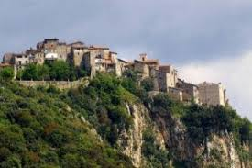
Norma
This town is well-known for the archeological site of the ancient Norba founded in 499 B.C.

Slide 6
