Slide 1
THE HISTORY OF «POLENTA»
IN SERMONETA
teacher FIORELLA NOCE

Slide 2
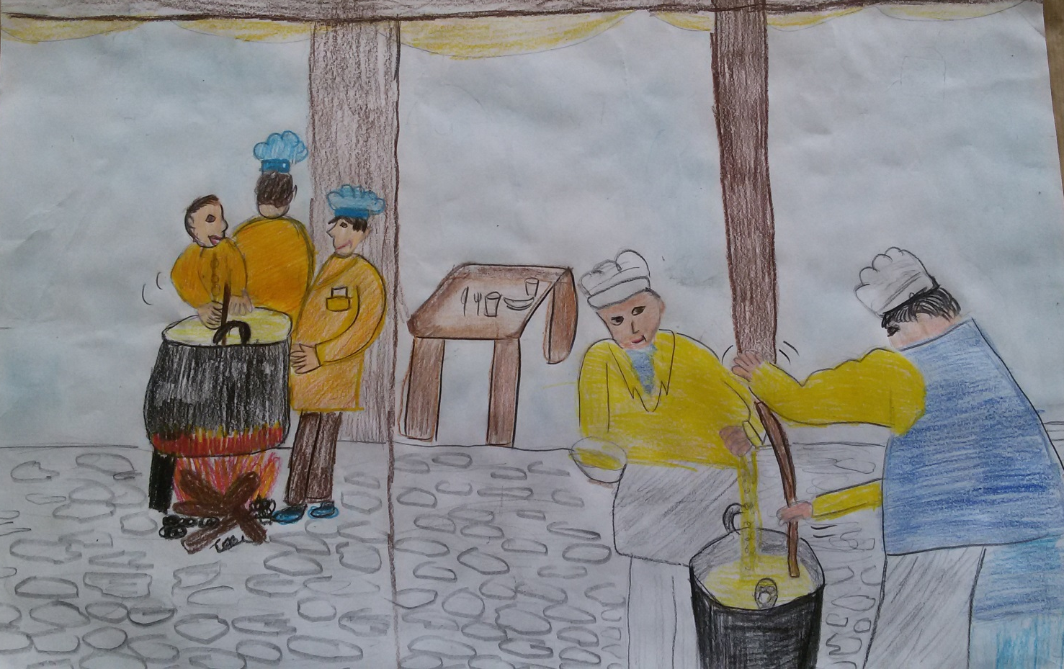
La storia della polenta a Sermoneta

Slide 3
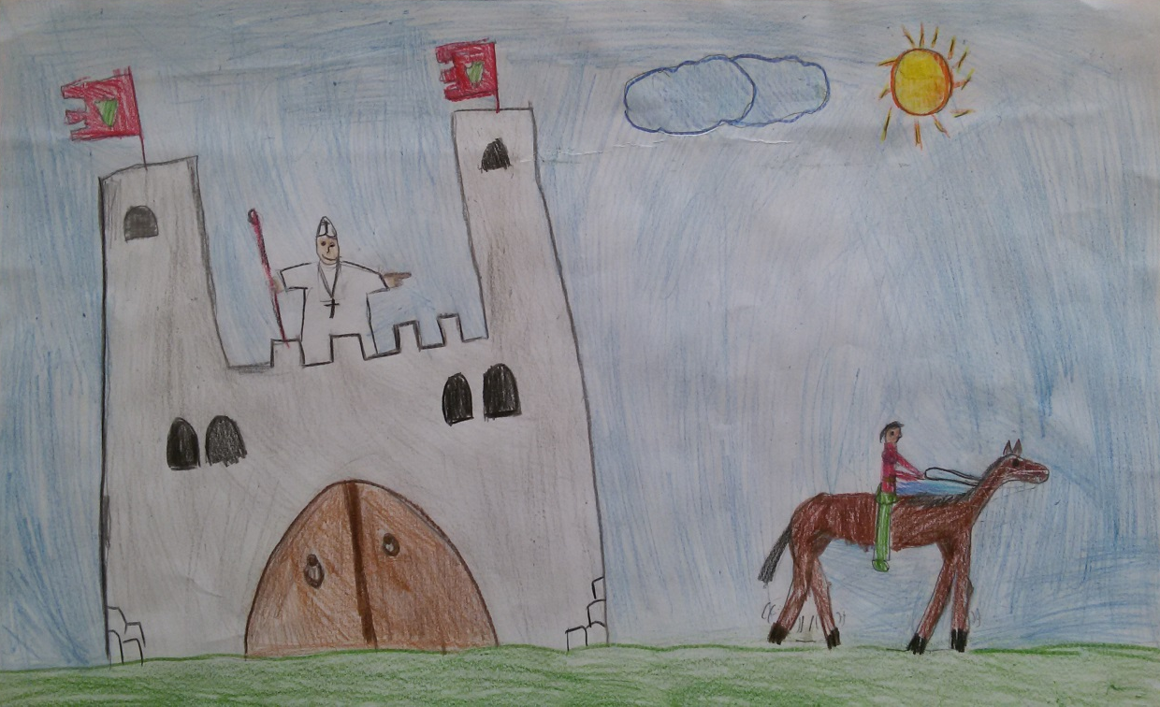
In 1499 Pope Alessandro VI of Borgia family took the fortress of Sermoneta and chased away Caetani family.
Only Guglielmo Caetani managed to run away just in time.

Slide 4
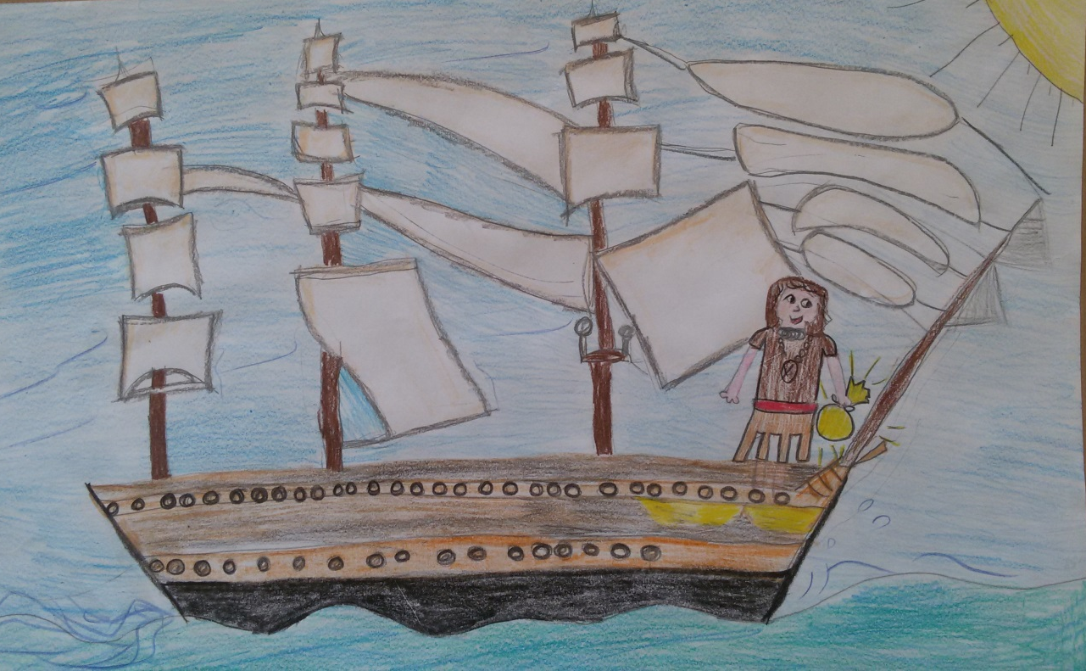
He lived in exile for five years; during this period he went to America with Amerigo Vespucci. From this travel he brought back some seeds of corn called in Italian «mais».

Slide 5
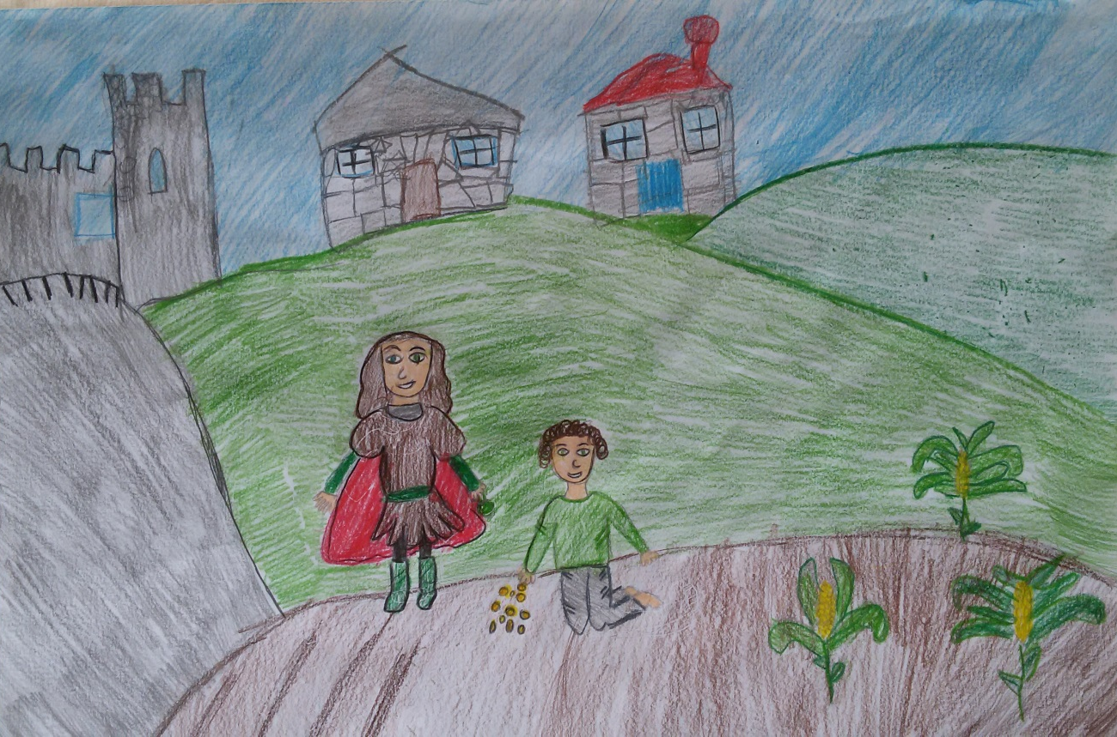
When Guglielmo Caetani came back to Sermoneta trayed to sow the «mais». He got a good harvest.

Slide 6
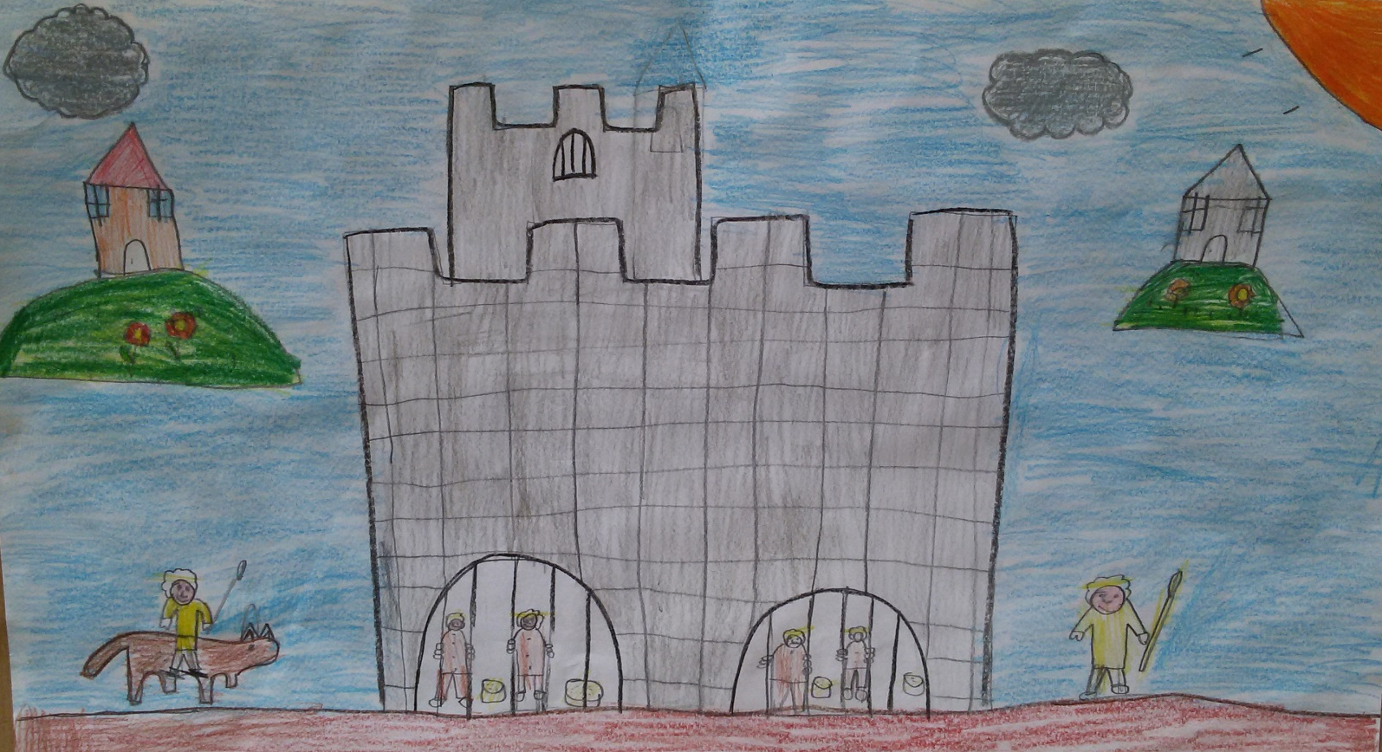
He ordered to prepare with the mais flour a mush for the prisoners of the castle; they liked very much.

Slide 7
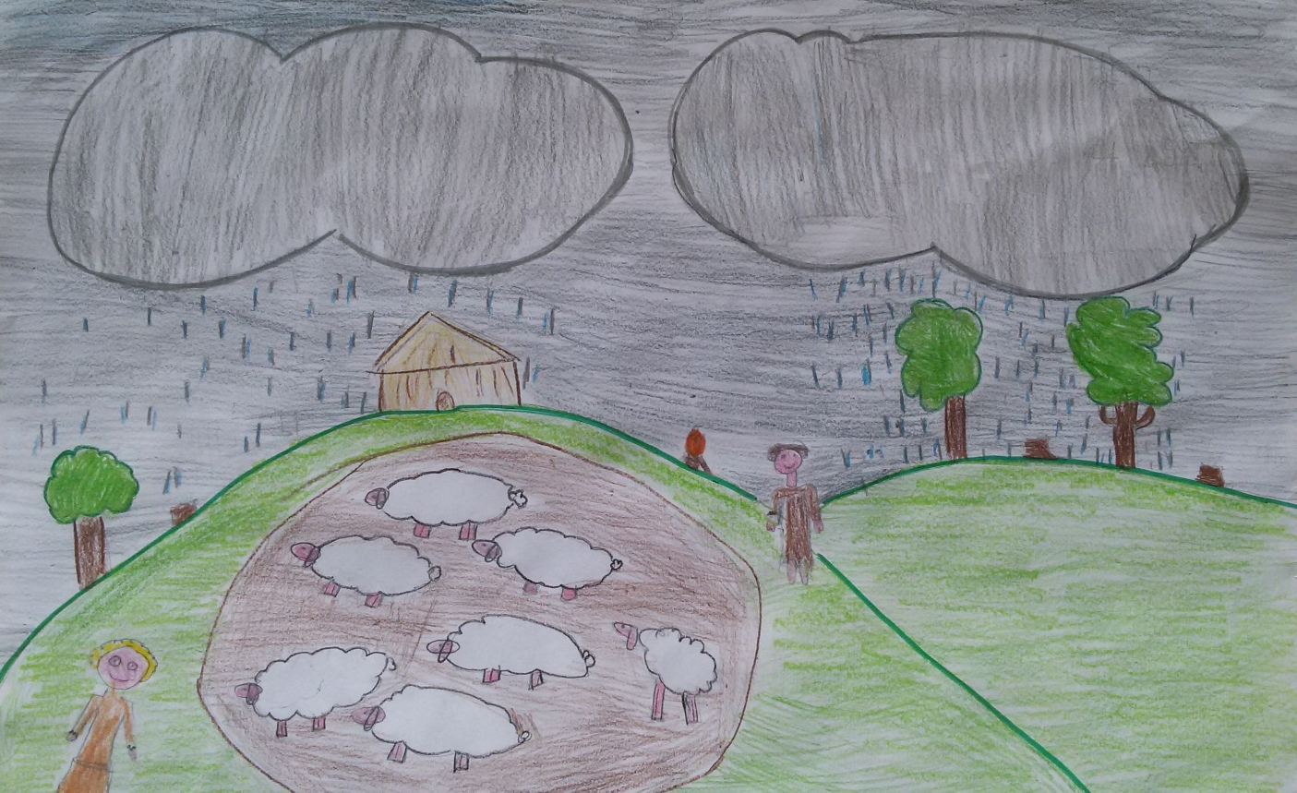
The new dish became well-known and was appreciated by the shepards who lived in the Lepini mountains with their livestocks .

Slide 8
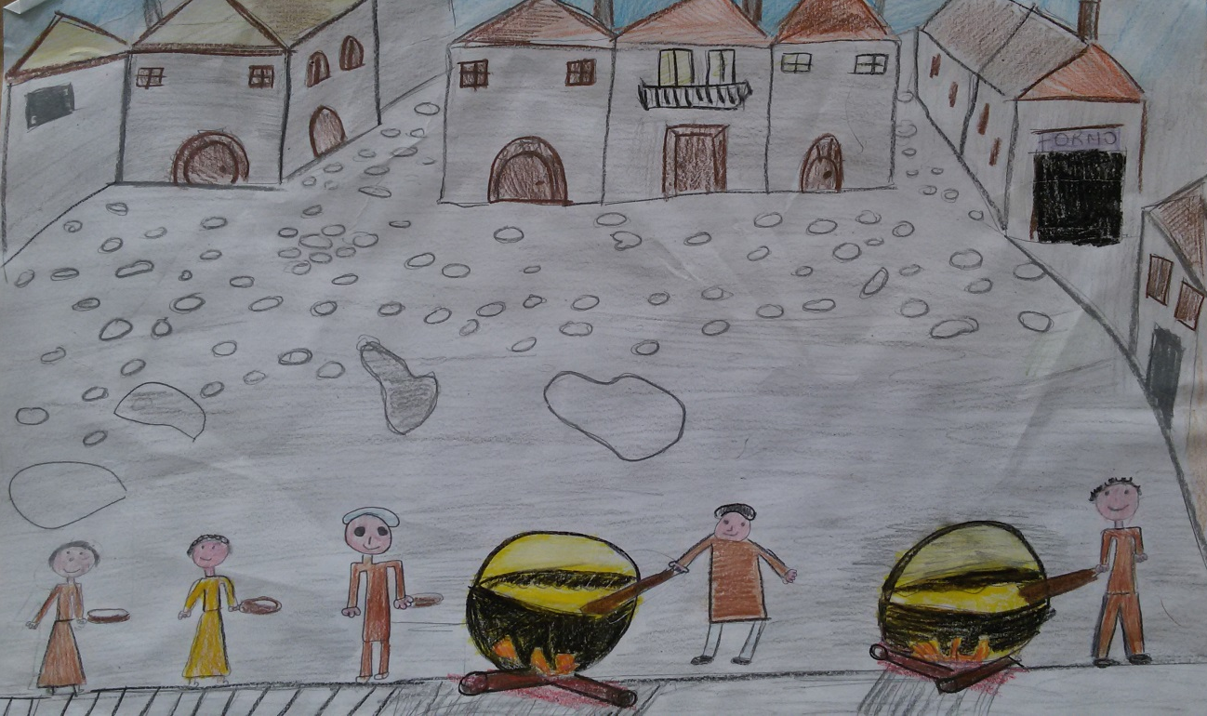
The the Duke Guglielmo allowed that in the day dedicated to S. Antonio Abate (January 17th) the new food called «Polenta» was distributed with pork sauce among all inhabitants. So it began the Carnival of Sermoneta.

